Slide 1


Programming Bongo Drum

Slide 2
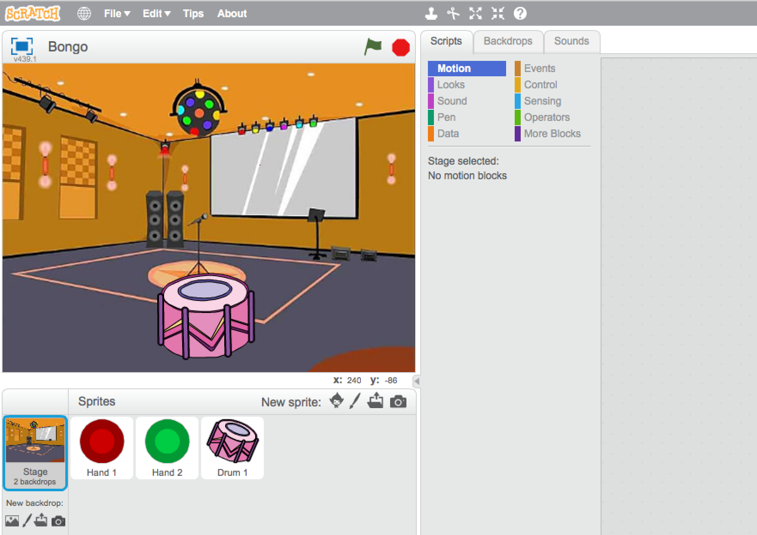
Bongo
We are going to create a bongo drum game
Let’s start with opening the project ‘Bongo.sb2’.
Go to File -> Open and pick ‘Bongo.sb2’
Notes:
Bij deze opdracht maken we een programma om te kunnen trommelen.
Hiervoor moet je het project ‘opdracht_bongo.sb2’ openen.
Dat doe je door in het menu te kiezen voor:
Bestand->Open
En kies dan ‘Bongo.sb2’

Slide 3
Bongo
The project is now ready.
As you can see, the party is about to get started! The speakers are connected. The drum is in place.
Let’s get this party started. We are going to add
Drum sounds when we hit the drum
A friend who dances to the drum
Notes:
Je ziet een feestzaal met een drum.
Jij moet de drum geluid laten maken wanneer je er op slaat.
Het programma is nu een beetje saai, we gaan het leuker maken door:
De drum geluid te laten maken als we hem raken.
Een danser toe te voegen.

Slide 4
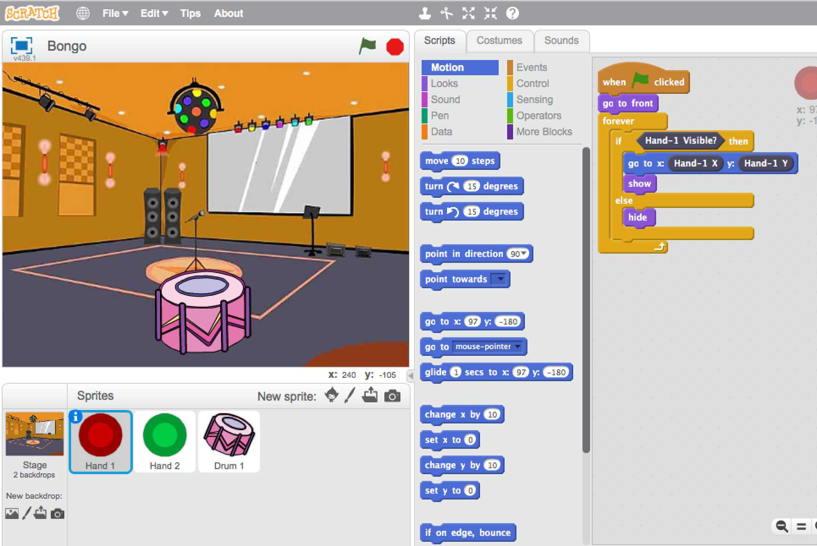
Bongo
Let’s see what happends when we click on the green flag.
If you hold both your hands above the leap motion, the red and green circles will appear and follow your hand movements.
When you pull your hands, the circles will disappear.
Lets try it!

Slide 5
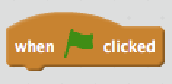
Bongo
Nothing happends when you move your hands over the drum, let’s change that!
Click on the drum in the Sprite window. On the right, you will see the the scripts building blocks.
It only contains the starting block. Nothing will happen when we run the program.
Next, we are going to add all the blocks we need, so that we can really drum with our hands.

Slide 6
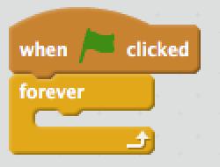
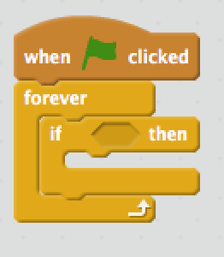
Bongo
First, we need to add the ‘forever’ block, so that the program keeps repeating itself
Click on ‘Control’ and drag the ‘forever’ block to the program area, underneath the start-block.
Next, we are going to create the part of the instruction that checks if the hand touches the drum. For that we need a if-than block.
Drag the ‘if - then’ block onto the program area and drop it inside the forever block.

Slide 7
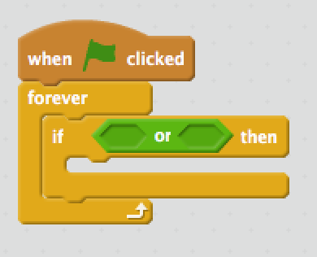
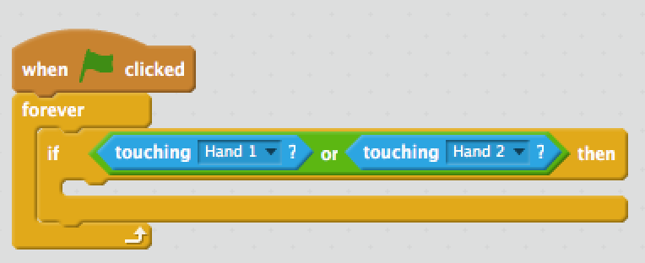
Bongo
Next, we are going to create the condition that determines if the drum is ‘touched’. We want this condition to be true if the sprite hand1 or hand2 touches the drum. We start with an or-block
Click on ‘Operators’, then drag the ‘or’ block into the ‘if’-block.
Click on ‘Sensing’, then drag two ‘touching ?’ blocks into the diamond shaped area within the ‘or’-block.
Next, click on the arrow in the first block and select ‘Hand 1’, and click on the second block and select ‘Hand 2’

Slide 8
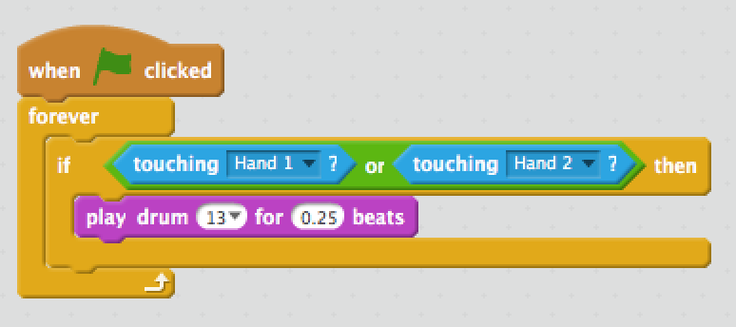
Bongo
We want the drum to make some sound whem we touch it.
Click on ‘Sound’, en then drag the ‘play drum for - beats’ into ‘if – then’ block. Click the first arrow and select a sound of your choise.
Try and click on the green flag, and see what happends.
If you move a hand towards the drum, the drum starts. If you move your hand away from the drum, the sound continues. That’s not good. Let’s fix this!

Slide 9
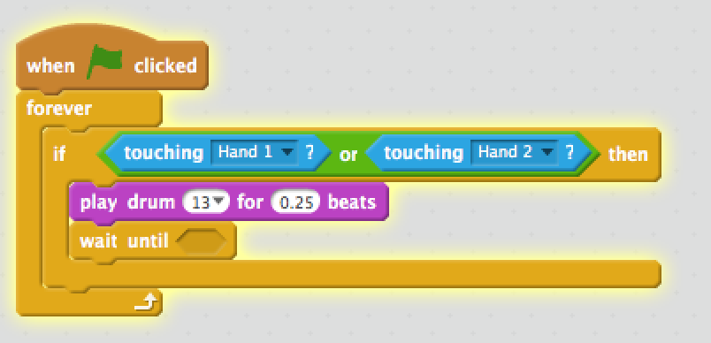
Bongo
We only want the drum to make sound if we touch it.
We can make the program wait until both hands are not touching the drum anymore, before it starts checking again.
Click ‘Control’ and drag the ‘wait until’- block underneath the ‘play drum’ block
Next we will create the condition that checks that the drum is not touched by both hands

Slide 10
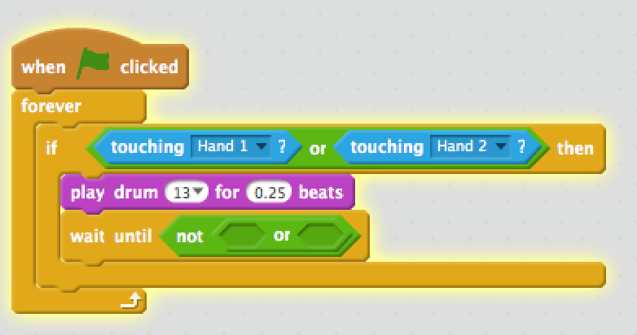
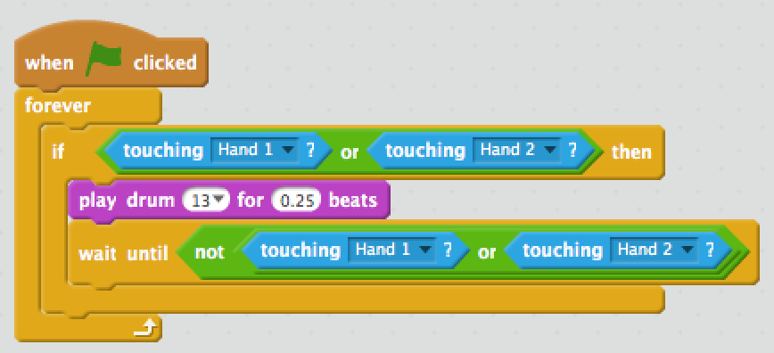
Bongo
Click on the ‘Operations’ block, and drag the ‘not’ into the ‘wait until’ block. After that, we need to drag a ‘or’ block into the ‘not’ block
Click on ‘Sensing’, then drag two ‘touching ?’ blocks into the diamond shaped area within the ‘or’-block.
Next, click on the arrow in the first block and select ‘Hand 1’, and click on the second block and select ‘Hand 2’
Now, retry the program again

Slide 11
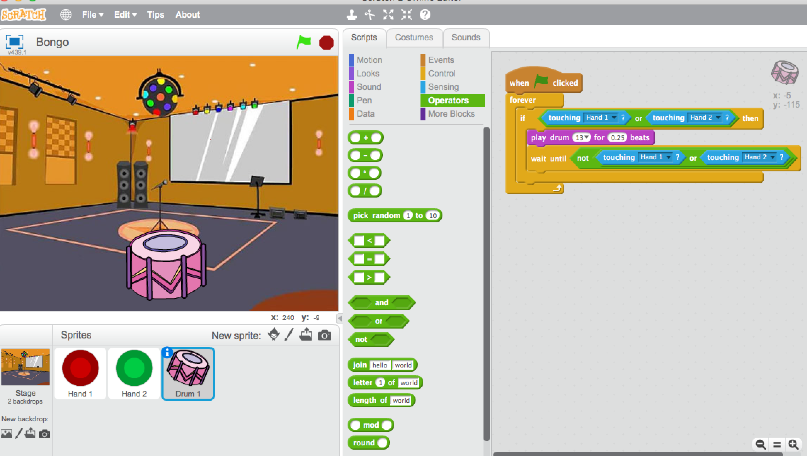
Bongo
Everything is working! Now we are going to add a dancer who dances to the beat of the drum. We are going to add a sprite

Slide 12
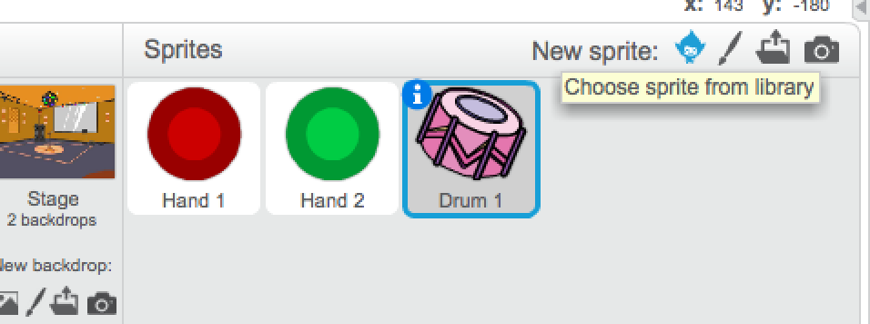
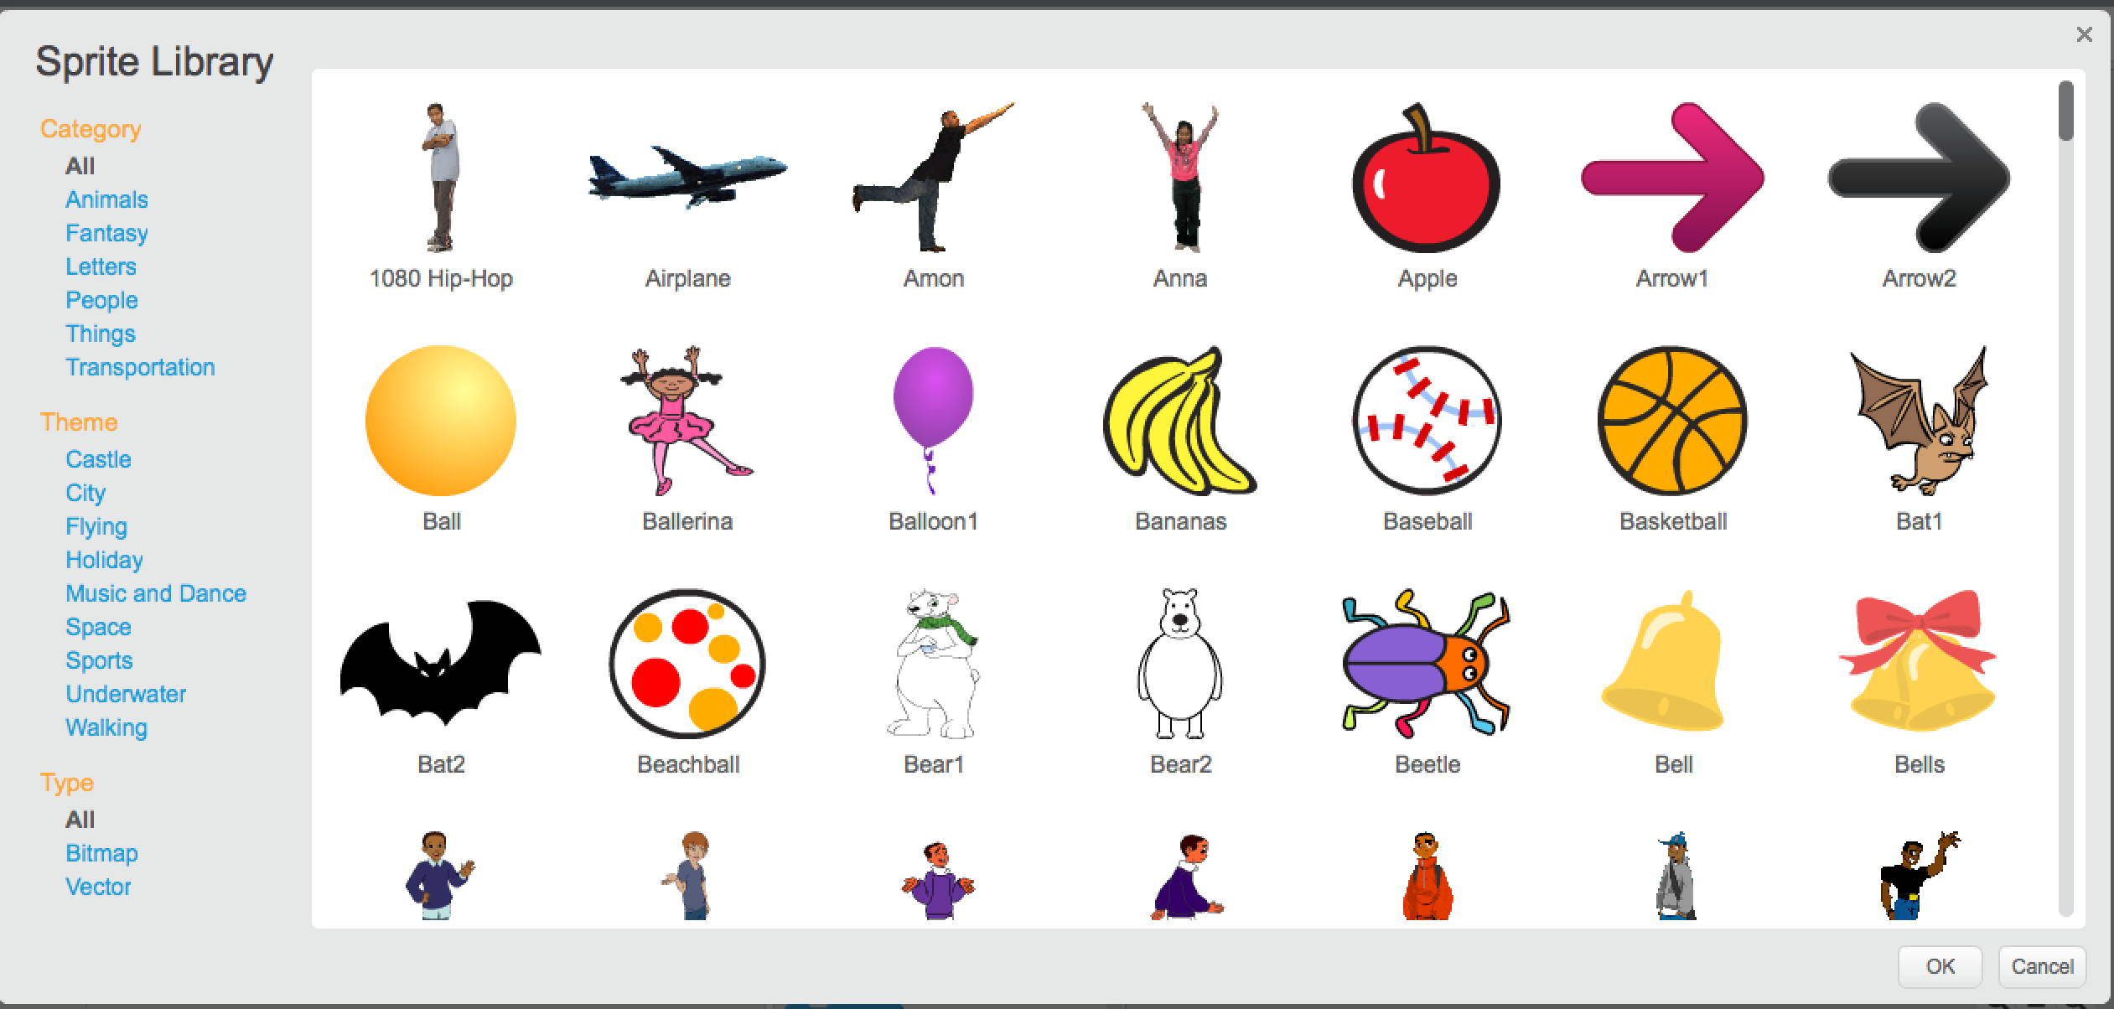
Bongo
You can add a new sprite by clicking on the avatar in the sprites panel.
Select the ‘Music and Dance’ theme and pick one of the Hip-Hop characters.

Slide 13
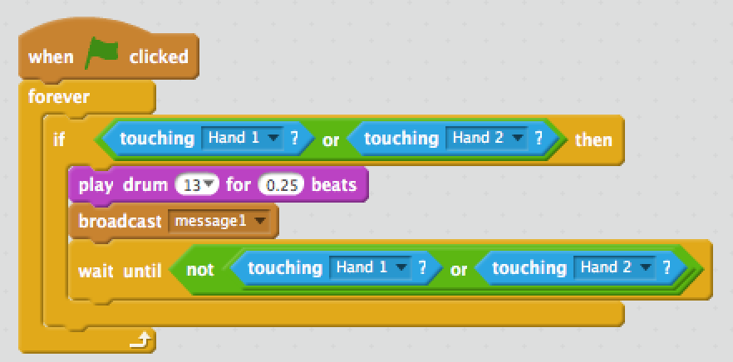
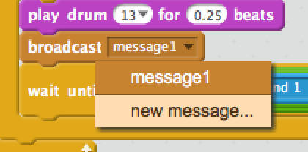
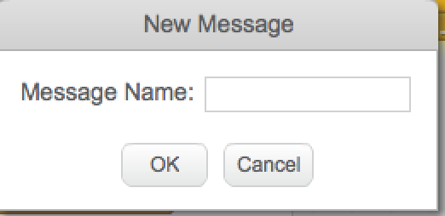
Bongo
Now we have to give the dancer sprite instructions to dance to the beat. We can do this by making the drumb send out a specific message when the drum is hit.
Select the drum sprite
Click on ‘Events’, and drag the ‘broadcast signal’ block in between the
‘play drum’ and ‘wait until blocks
Click on ‘message 1’ and select ‘new message…’
Name the message ‘drum hit’ and click OK

Slide 14

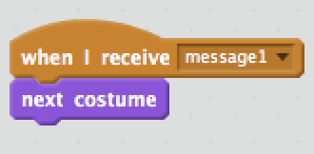
Bongo
Now, we wil make the dancer move if he/she receives the ‘drum hit’ signal
Select the dancers sprite.
Click on ‘Events’ and drag the ‘when I receive message’ block onto the program field. Select the ‘drum hit’ message in the dropdown.
Click on ‘Looks’ and then drag the ‘next costume’ underneath the ’when I receive message’ block.

Slide 15
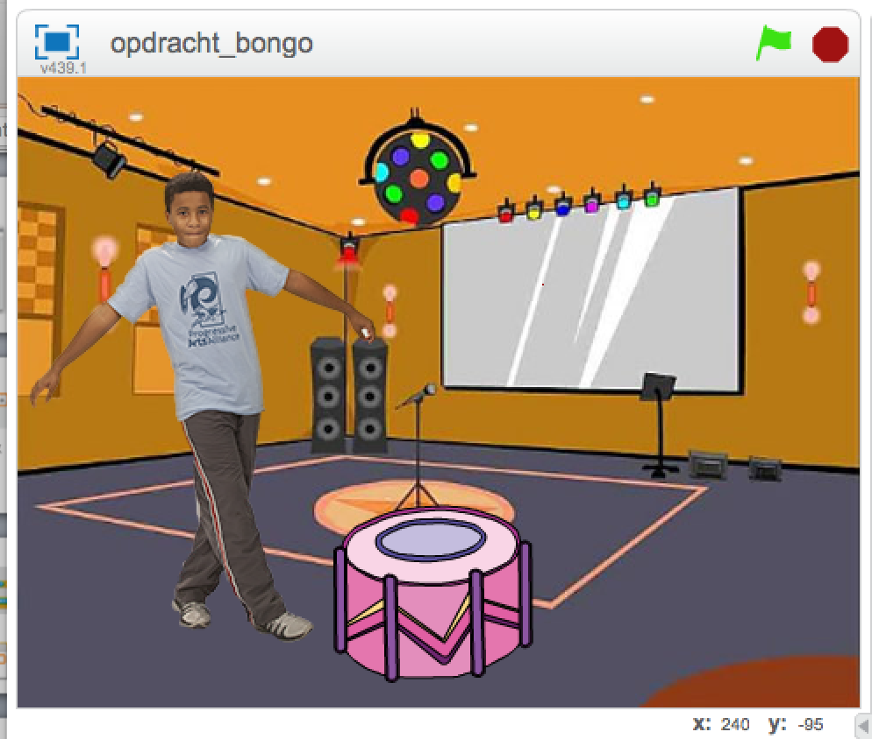
Bongo
Try to expand the program
You can do this by adding more dancers and more drums that make different sounds

